Slide 1
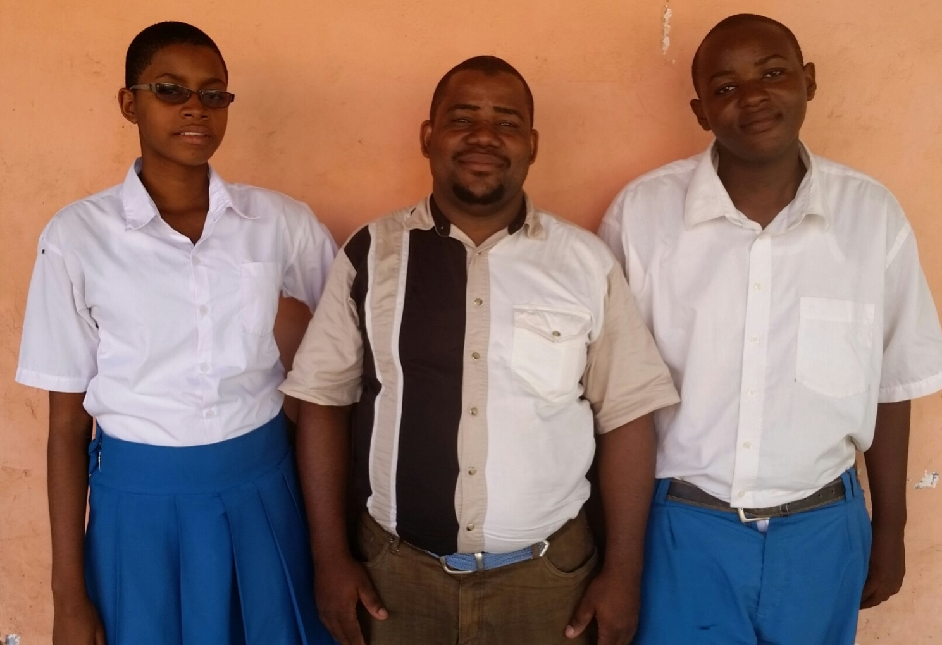
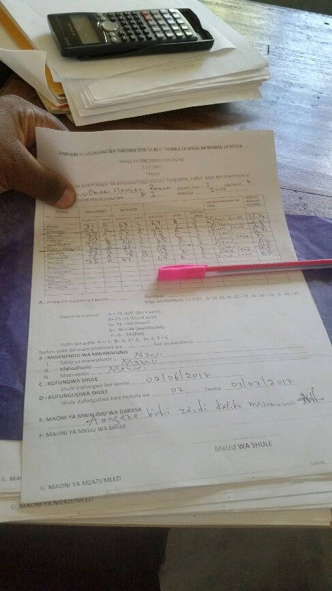
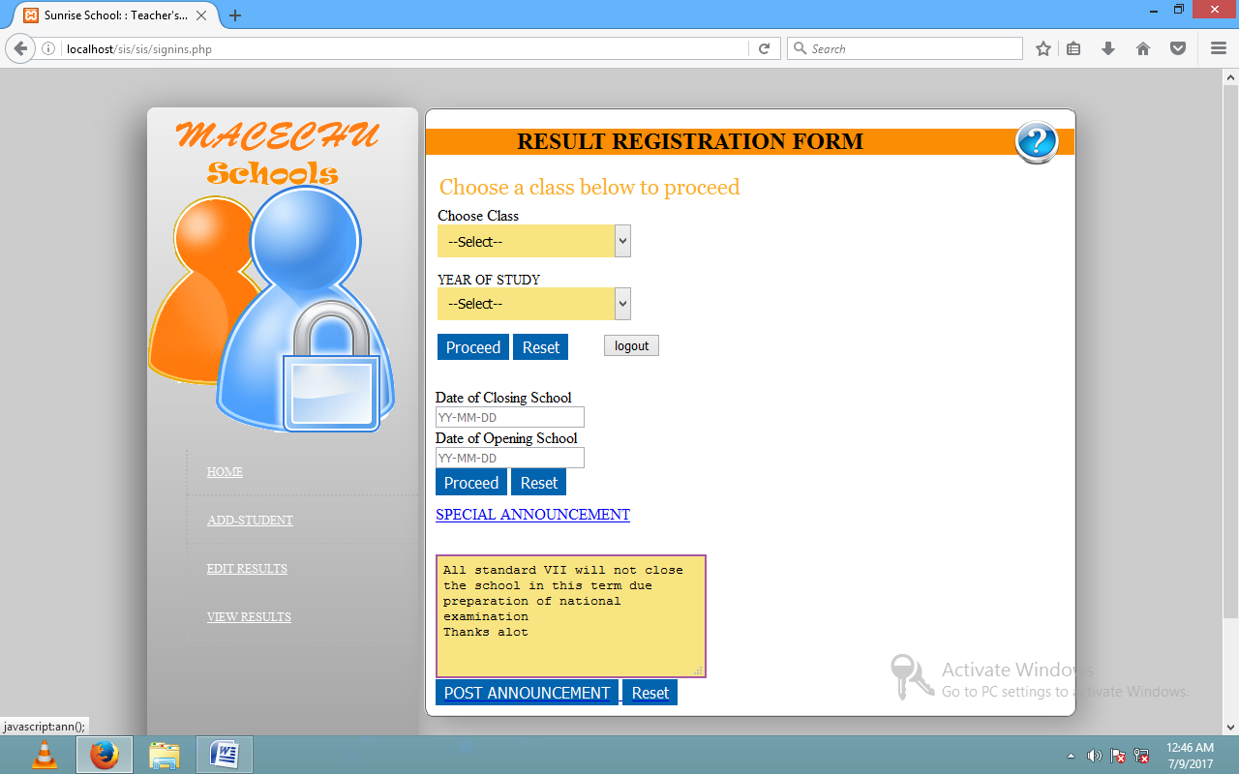
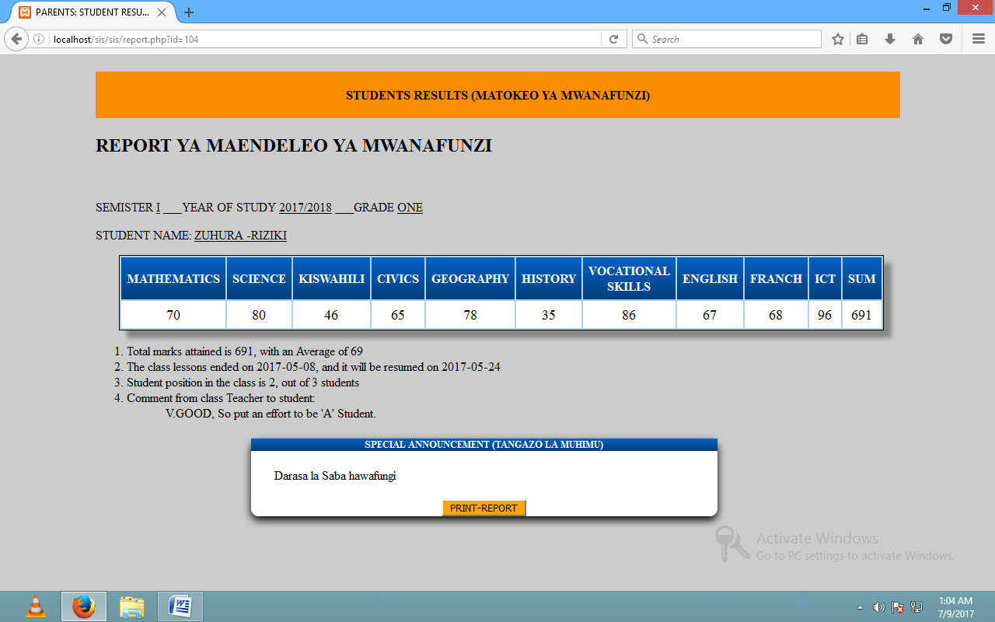
63.
ICT Solution for Students Results
Macechu Secondary School
Zuhura Riziki and Focus Seth
Abstract:
Results Processing System (RPS) is the system which is now able to process students’ results for different students in Primary schools in Tanga City and display grade and average for each student in different classes with remarks such as distinction, merits, credit, pass and fail. Not only that but the system is also able to rank students in position depending on student results and school grades.
This project was aimed to us a computer knowledge by creating a web-based system for processing and dissemination of students’ results electronically so as to solve the students’ results problem in boarding primary schools in Tanga City especially for the students come from far regions in Tanzania.
Method:
This project was conducted by using questionnaire and interview through three different boarding primary schools namely; Raskazone English Medium Primary School, Avicenna English Medium Islamic Primary School and Eben- enzeri English Medium Primary School
Also this project was required the following:-
System tools-HTML5 (hypertext makeup language), CSS3 (cascading style sheet), JavaScript, Jquery, Note pad ⁺⁺, amazing slider, Logo creator, Platform: Windows Operating System, Object Oriented PHP5.
Data base –My SQL (structural query language)
Host-local host example XAMPP
System requirement-Laptop with hard disk at least 250GB, RAM-4GB, Processor-1.5GHz or 2GHz, Modem and Flash drive, System users School admin (Academic members)and Parents.
School | standard v |  | standard vi
 | positive | negative | positive | negative
Raskazone | 25 | 05 | 27 | 03
Percentage (%) | 83.33 | 16.67 | 90 | 10
Avicenna | 20 | 09 | 25 | 05
Percentage (%) | 68.97 | 31.03 | 83.33 | 16.67
Eben-ezeri | 27 | 03 | 29 | 01
Percentage (%) | 90 | 10 | 96.67 | 3.33
Results:
SYSTEM DEVELOPMENT MODEL
During system design and development we used the water fall model.
Reasons for choosing water fall model
The model is simple and easy to understand and use.
Waterfall model works well for smaller projects where requirements are very well understood. Also, in this model phases are processed and completed one at a time. Phases do not overlap.
The results from three Primary Schools were shown that, 87.77% and 90% standard five and six students who come from different regions in Tanzania gave the positive response on requiring the help of using this Computer system respectively and 19.22% and 10% gave the negative response from standard five and standard six respectively.
And this was represented graphically as shown aside.
At the end of this project the deliver is the system which is capable to overcome most of problems faced to teachers and students as well as parents in PRIMARY SCHOOLS. The system is now capable to process and displays the students’ results in various classes.
Conclusions:
According to our survey and interview we observed that, the three primary schools are capable to use this Database system because they are well operationally, technically and economically. The system that we developed is one of the solutions to the problems facing most Tanzanian boarding primary schools and system will change the Schools from manual to digital system.
Therefore we met our objectives because the developed system stops the usage of manual ways of results processing for PRIMARY SCHOOLS. So that the computer Database system will simplify and eliminate the problem of students’ results in these primary schools and will prevent the wastage of time and transport fare to their parents.
References:
Duckett, J. (2011). HTML and CSS_Design and Build Websites-Wiley. Canada: Yourth-Core.
Michael, E. (2007). MySQL_Step-by-Step Guide to Creating Database-Driven Web sites-O’Reilly Media . India: GDH.
Omari, M. (2010). System analysis and design –Mitchell McGraw-Hill Watsonville. Ghana: SSL.

