Slide 1
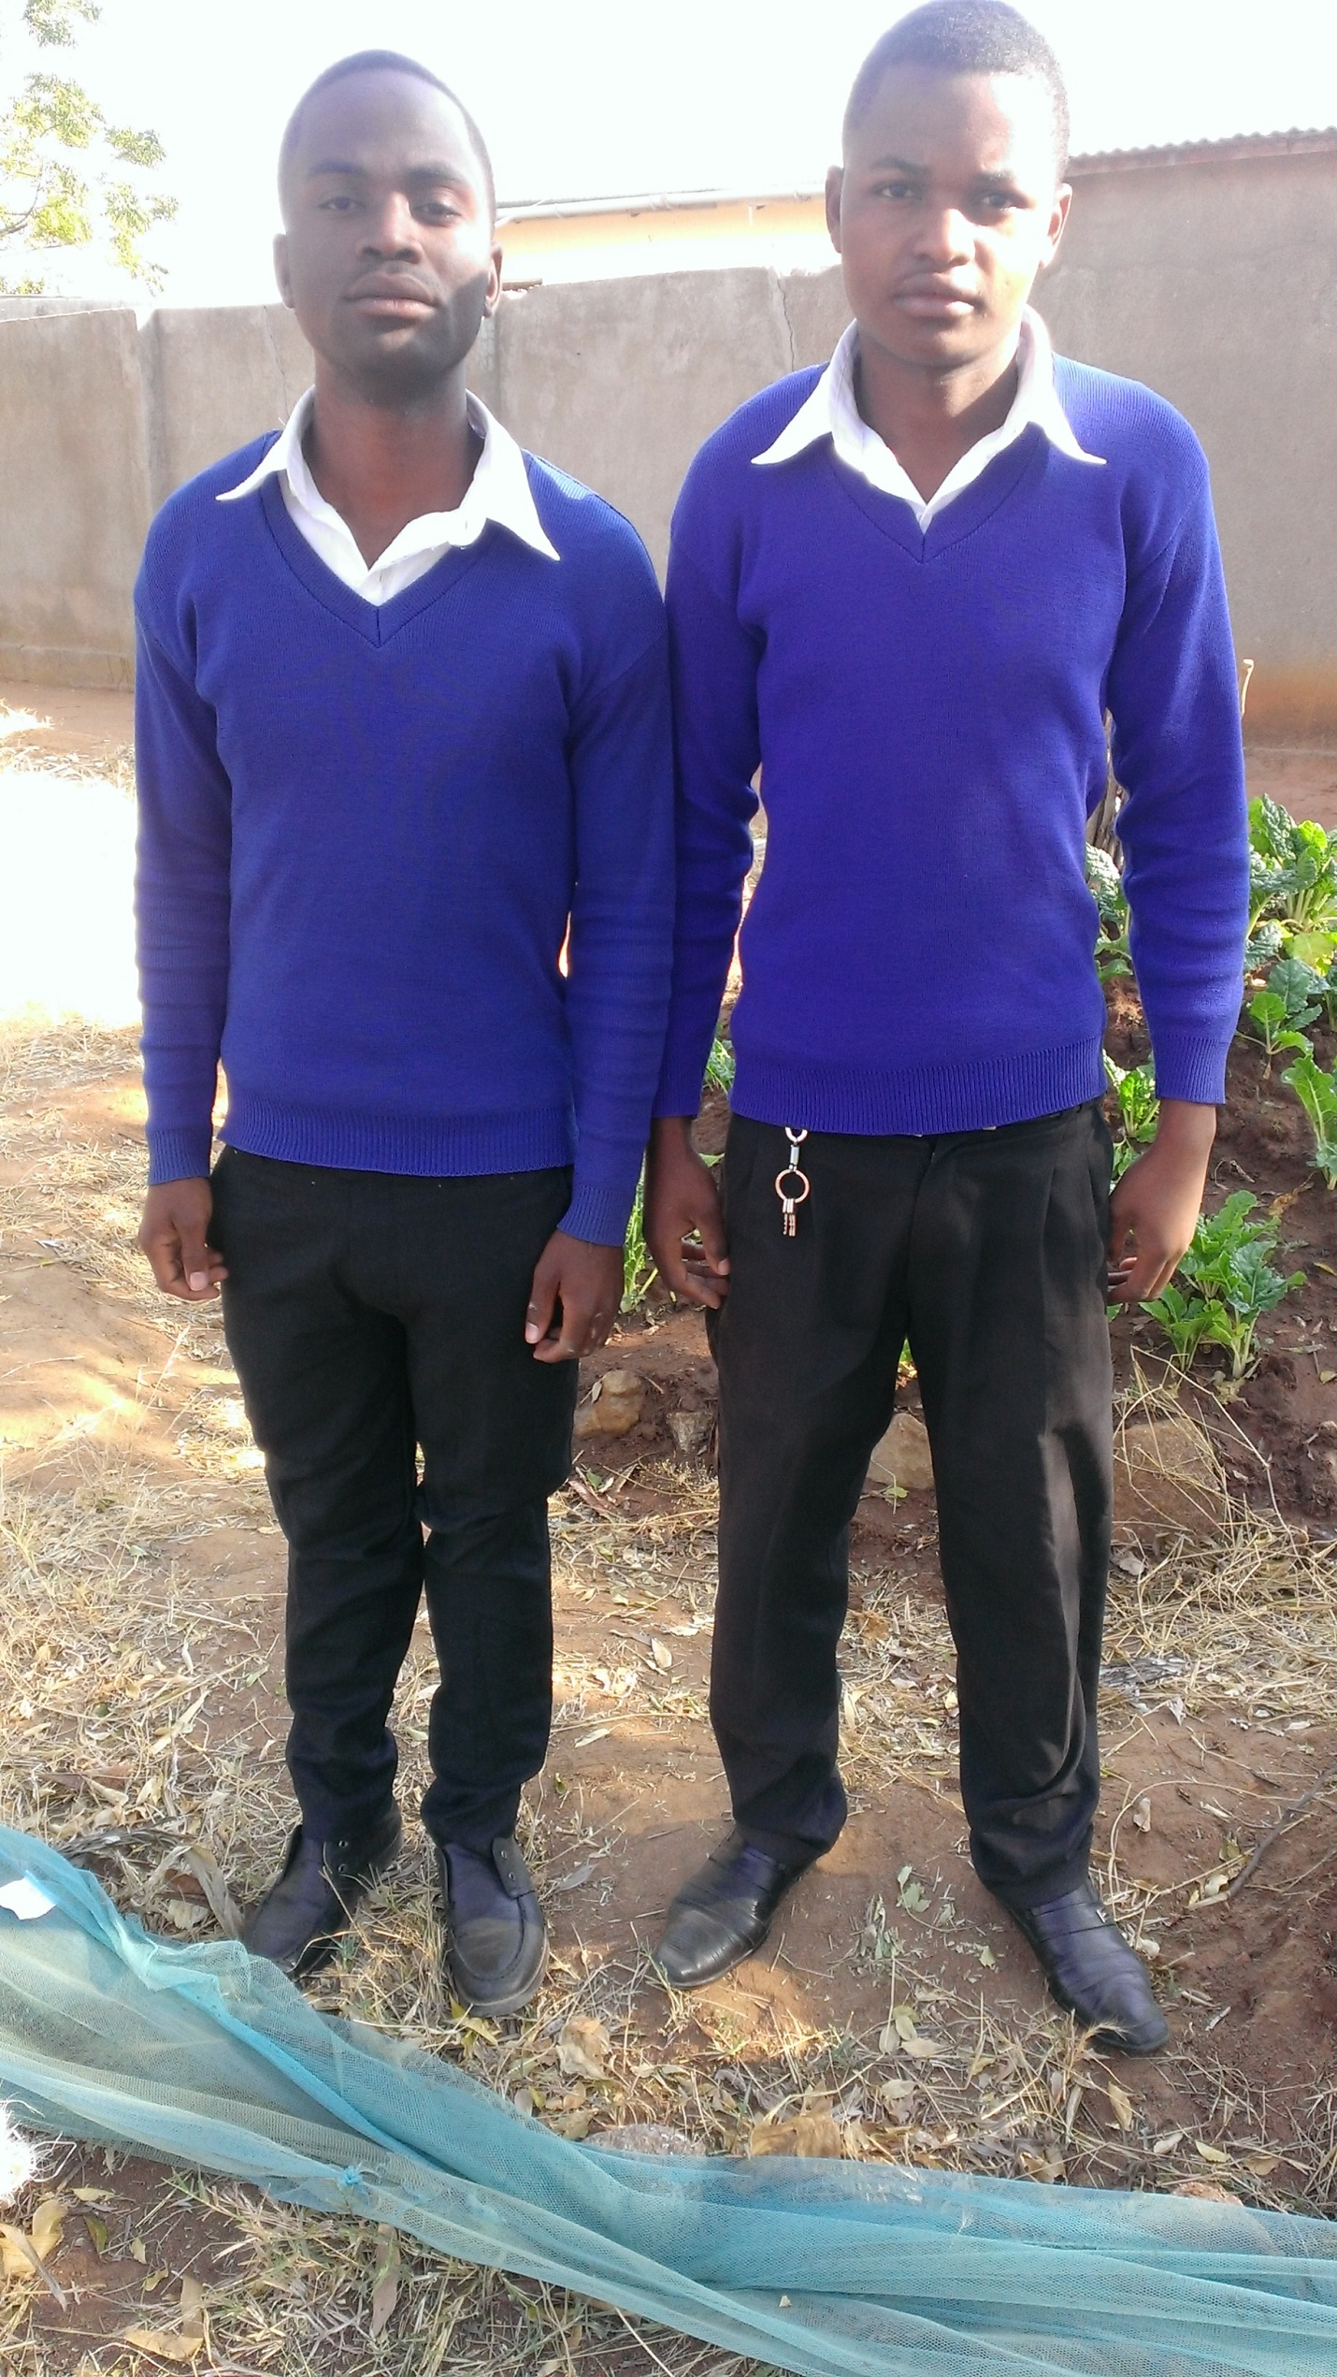
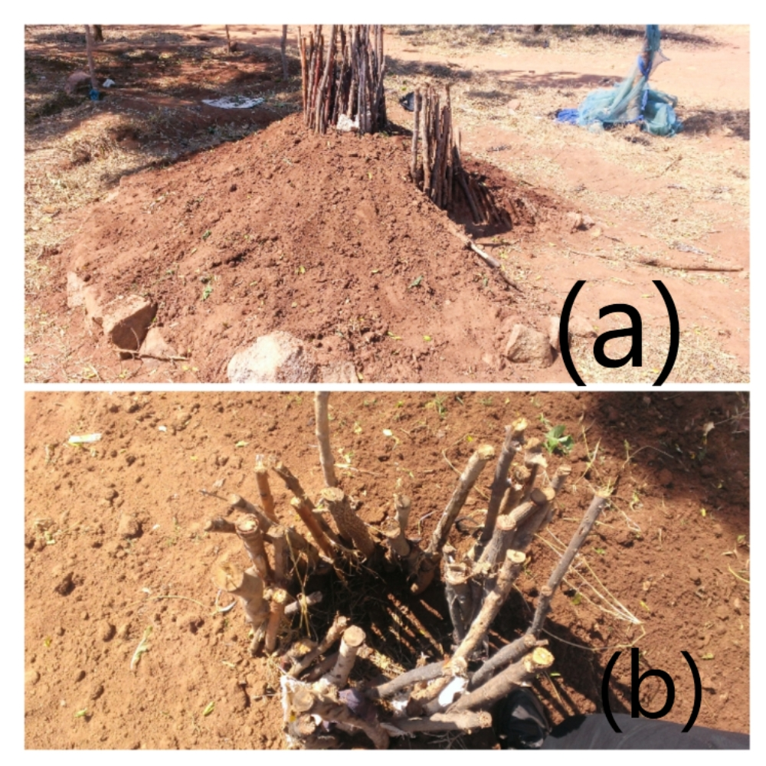
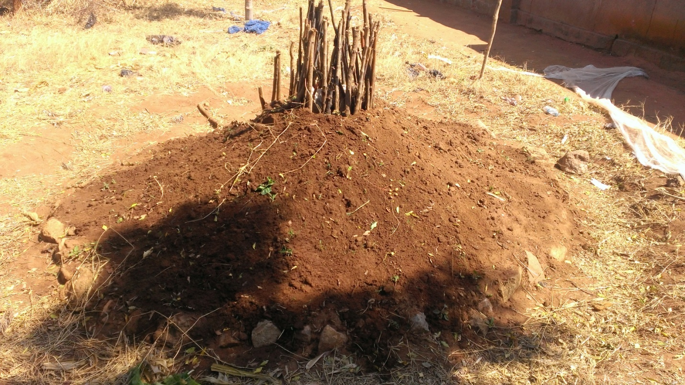
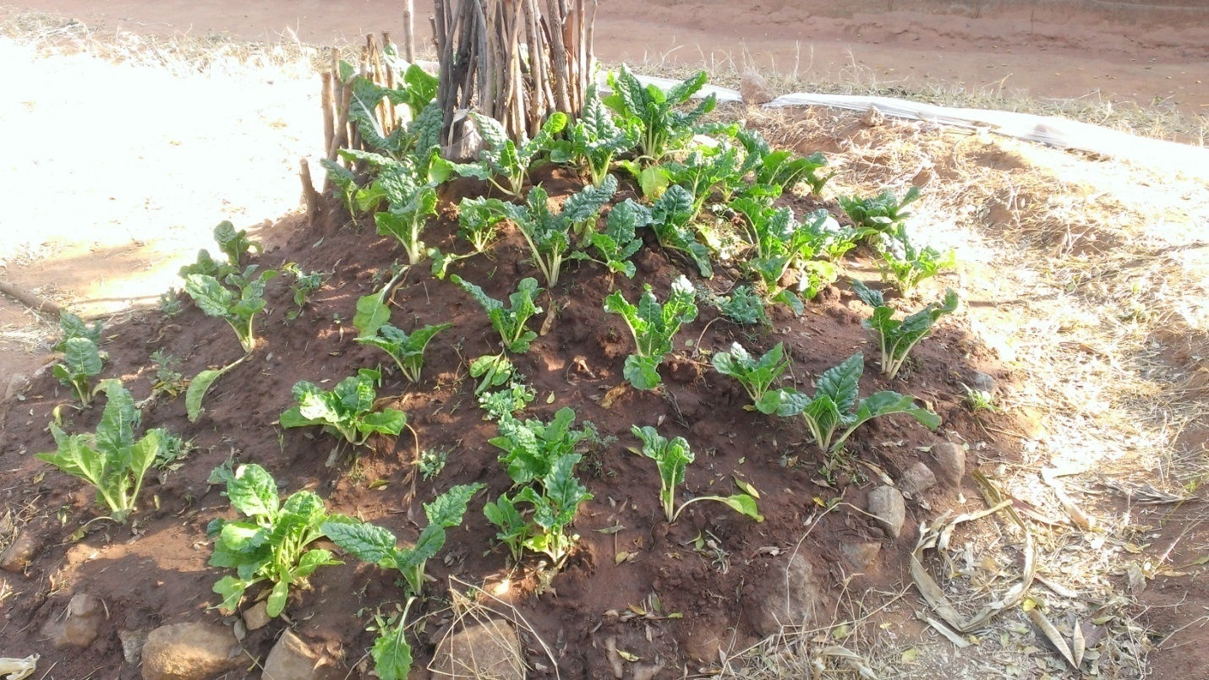
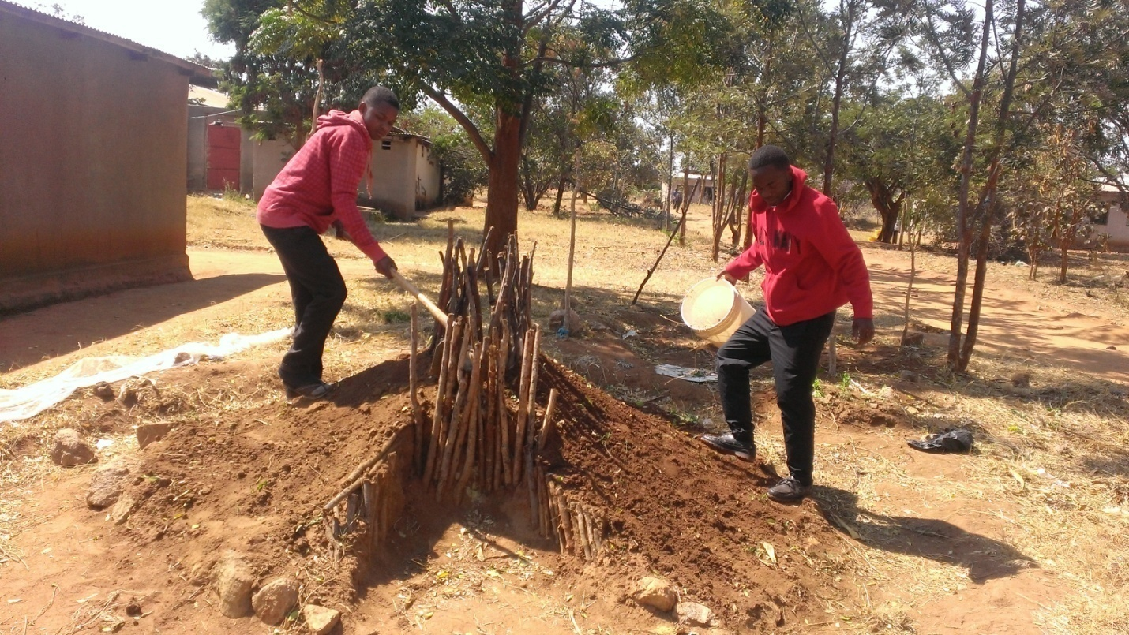
45.
The Household Hunger Score Project
Ilongero Secondary School
Julius Luchiga and Stanley Paul
Abstract:
According to different researches in our country (Tanzania) shows that farming and gardening in semi- arid regions eg.Singida, is difficult and give little crop yield, this is due to unreliable rainfall causing lack of enough water for proper growth of crops, in addition the area is sunny that the water on the ground evaporates so fast giving the land high affinity to water and low moisture conservation, hence become not conducive for proper production of crops and household vegetables.
Pertaining to this problem facing our society as young scientist from Ilongero High school in Singida, we have come up with a new gardening method of self watering garden which uses small amount of water and conserve moisture for long time and hence drought (persistence), therefore helps people in semi-arid regions to get high yield of household agricultural products in small area by using small amount of water.
Method:
The study was conducted at Ilongero village in Singida-Tanzania. The chosen area was small resembling to the free household lands in our families. The experiment was conducted at the middle of the dry season when there was no rainfall expected.
Preparation Of Land And Garden Layout
The composite manure was prepared in a suitable area using kitchen scraps, unwanted papers and other decomposing materials. The hard work was done by the microorganisms on decomposing the materials.
The two equal areas which are in circular form 2meters wide were prepared; one for the control experiment (C.E) and the other for the self watering garden (S.W.G).
The soil in both C.E and S.W.G was softened by small amount of water and was dug.
Decomposed manure was mixed with soil in both C.E and S.W.G in equal proportions. In addition natural manure was also mixed to the C.E while the same amount of manure was put in the circular chamber of the S.W.G
Construction Of Self Watering Garden (S.W.G).
The self watering garden was constructed using local materials which were found in Ilongero village, such materials were dry sticks (135cm in length), stones, ropes made of inner parts of bark of Mghunga tree and well drainage top soil with decaying plant materials plus some rotten manure .
The garden as shown in figure.1 has a circular chamber at the centre made of dry sticks that is half filled with manure, in this way water is poured at the chamber throughout the growing season.
Results:
The harvesting was done 27 days after transplanting making a total of 45 days.
Relative growth rate of spinach leave in S.W.G was ≈ 5.4cm per week that is equivalent to 0.77cm per day while in the C.E was ≈ 3.8cm per week that is equivalently to 0.54cm per day shown
The spinach leaves in S.W.G were much wider than the spinach leaves in the C.E
The quantity of products in the S.W.G was 3375gms while in the C.E was 1350gms which is less than its half.
Quality of the products in the S.W.G was seen to be better compared to products in the C.E because in the S.W.G the leaves grew up more healthier than in the C.E
The spinach in the S.W.G matured faster than in the C.E within the same period of time.
Conclusions:
From the above observations we inferred the following deductions;
The faster maturing of spinach leaves in the S.W.G was due to the availability of moisture in garden all the time thus there were a constant supply of water to the plants.
The better quality and growth rate of the spinach leaves in the S.W.G was due to a good supply of nutrients to the garden as the method avoids leaching of nutrients thus the roots in this garden developed with a good constant supply of nutrients. In the control experiment (C.E), leaching reduced the concentration of nutrients on the ground to down where the roots can’t reach.
Also direct heat from the mid-day sun on the nearly flat surface of the C.E increased soil water evaporation compared to sloped land.
In the S.W.G the quantity of the products was higher than in the control experiment because of the designed form of the garden bed increases the surface area.

