Slide 1
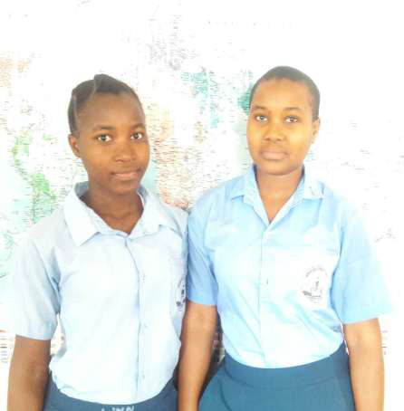
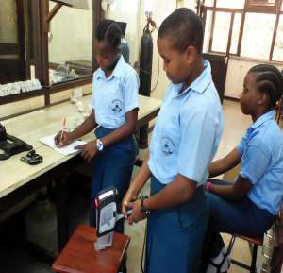
38.
X-Ray Fluorescence to Determine Toxic Metals In Soil
Premier Girls Secondary School
Editha Timothy and Specioza Magesa
Abstract:
This study aims at determining the levels of toxic metals in the densely populated and rapidly growing city of Dar es salaam particularly Sinza area and the old buildings of Bagamoyo. The results presented in this work show that most samples from Bagamoyo area have low levels of toxic metal pollution as compared to WHO established standards for allowable limits of metal contents in soils. However, they are higher than metal concentrations obtained from previous studies in different parts of Dar es salaam City and other parts of the country (Ak’habuhaya Jonathan and Lodenus Martin 1988, Machiwa 1992, Kishe-machumu 2003, Mwegoha and Kihampa 2010). This implies that as time goes on, the metal concentrations will keep on increase due to the peeling away of the paints from the buildings which is toxic to people and other ecosystems around the area.
Method:
The study was carried out at Sinza area in Dar es salaam and Bagamoyo at Mwambao area. The selection of Sinza area was due to the reason that it is one of the densely populated areas in Dar es salaam containing numerous workshops such as soldering and welding workshops that are possible sources of toxic metals in the environment.
Bagamoyo area was selected due to the presence of numerous old buildings which act as sources of toxic metals to the surrounding soils since old paints contained toxic element Lead (Pb) as one of its components.
Samples at Sinza area were taken around welding workshops whereby at each workshop 3 soil samples of 500g each were taken at distances 0m, 1m and 5m from the center of the workshop where most welding activities are mostly conducted. Samples from the old buildings of Bagamoyo were taken at the foundation of the building, 2m and 5m
next to the building. The essence was to obtain the relationship between metal levels in soils and the distance from the source of dispersion of the metals.
Portable X-Ray Fluorescence (pXRF) analysis
Metal determination in the soil samples was done using a Portable X-Ray Fluorescence analyzer, Delta classic model with Tantalum anode in the mining and soil modes. The finer fraction of the samples less than 250μ were analyzed together with standard samples NIST 2711a, NIST 2710a and Pure Silica (Si so as to check the accuracy and precision of the instrument. The Portable XRF was calibrated before starting the measurements and after every ten sample interval. Each sample was analyzed three times for a 60 seconds exposure time and the average reading was taken as the result for further interpretation.
Results:
The levels of toxic metals obtained in Sinza area are as shown in Table 1. Iron concentration was highest in SNZ 001A (286318 ± 5658ppm) and lowest at SNZ 003C (15373±278ppm) whereas copper was highest in SNZ 002A (686 ± 30ppm). Zinc levels were highest at SNZ 002A (1199 ± 36ppm) and lowest at SNZ 003C (85 ± 9ppm),Lead was highest at SNZ 002A (501±19ppm) while Mn was highest at SNZ 001A (1684±104ppm).
Conclusions:
The investigation on toxic metal contents from Bagamoyo and Sinza area showed that the concentration of toxic metals decrease with increasing distance from the building and workshop respectively except for a few samples that showed a pattern different from the expected pattern. This may be caused by the continuous erosion of the soil by water and the presence of transported soils in the area brought to the site for rehabilitation and other construction activities.
High toxic metal contents in Sinza area than the WHO permissible levels of toxic metals in soils and the results from previous studies imply that the area is highly polluted with toxic metals posing a high risk to people living in the surrounding areas.
Conclusions:
We also extend our sincere and heartfelt gratitude to our supervisor Mr.Emmanuel Bundala and all the management team of Premier girls secondary school whose incessant guidance and invaluable inputs and encouragement have been a source of great inspiration to us in completing our work.
Lastly we acknowledge Dr. Charles Messo and the Department of Geology at the University of Dar es salaam who assisted us in sample preparation and analysis by Portable X-Ray Fluorescence analyzer.

