Slide 1
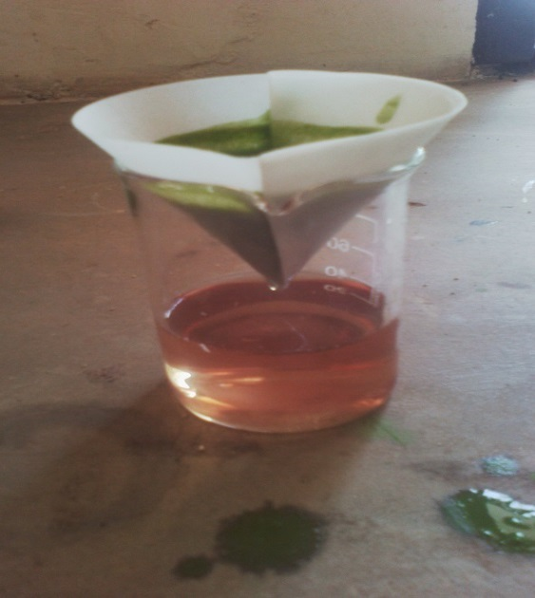
37.
If Bryophyllum Plant is a Natural Laboratory Reagent
Mwananchi Secondary School
Lucas Kibila and Stide Shedrack
Abstract:
There are different laboratory reagents for scientific studies which are made from industries. However the other outlook can be the uses of natural laboratory reagents extracted from plant fluids. This project aimed at investigating bryophyllum plant fluid as complex organic compound which may provide effective chemical reactions with different chemical substances.
Therefore use it to identify if Iron ions or Lead ions are available in a sample of chemical substances. Such plant was selected as case study because it is succulent in its nature. Few leaves can be grind and produce significant quantity of liquid.
Method:
Experiments to investigate if Bryophyllum fluid has some effects with salts compounds. The following materials were used:
Bryophyllum leaves, motor and pestle, test tubes, beakers, droppers, filter paper, Iron (III) Chloride, Iron (III) Nitrate, Iron (II) sulphate and Iron Carbonate, Lead (II) Chloride, Lead (II) nitrate, Lead acetate, Lead carbonate, Potassium hydroxide, Sodium hydroxide, Ammonium hydroxide, Calcium hydroxide and Sodium carbonate. Groves, litmus paper, and water.
sample solutions were prepared and categorized in main three groups.
GROUP ONE: Iron compounds:
Iron (III) chloride, Iron (III) nitrate, Iron (II) sulphate and Iron (II) carbonate.
GROUP TWO: Lead Compounds:
Lead (II) chloride, Lead (II) nitrate, Lead acetate and Lead carbonate
GROUP THREE: Alkaline Compounds:
Potassium hydroxide, Sodium hydroxide, Sodium carbonate, potassium hydrogen carbonate, Ammonium hydroxide and Calcium hydroxide.
Discussion:
Bryophyllum fluid is complex organic compound. It can supply both electrons and oxygen at the same time. So, it exercises redox reaction. When treated with Iron (III) chloride or Iron (III) nitrate, it oxidizes Iron (III) ions which are brown in colour to Iron (II) oxide which is black solution.
The black precipitates are Iron (II) oxide as it dissolves in dilute hydrochloric acid. This agrees with South Caroline State University, et al (2008), Chemistry for secondary school pg: 176, who stated that Fe (II) oxide (FeO) is insoluble in water but it can dissolve in hydrochloric acid to form Iron (II) chloride solution
Conclusions:
The experiment has shown that bryophyllum fluid can oxidize Iron (III) or Iron (II) to Iron (II) oxide. Therefore it can be used to identify the presence of Iron element in a given salt samples except salts with carbonates. Because carbonate is insoluble in this fluid.
The fluid also forms white precipitates with lead compounds except carbonates salts. This imply that it may be used to identify the presence of lead in given salt samples. When treated with alkaline substances, it gave yellow colour. Hence can distinguish alkaline salts from non-alkaline substances.
From these findings, it can be concluded that fluid from bryophyllum leaves can be used as natural laboratory reagent for scientific studies especially in qualitative analysis. So, it can minimize the uses of industrial reagents that contain toxic substances like cyanide and chromate when testing presence of Iron or lead.

