Slide 1
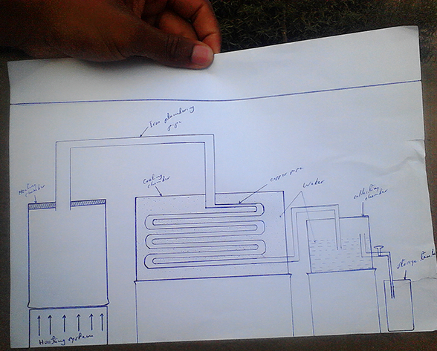
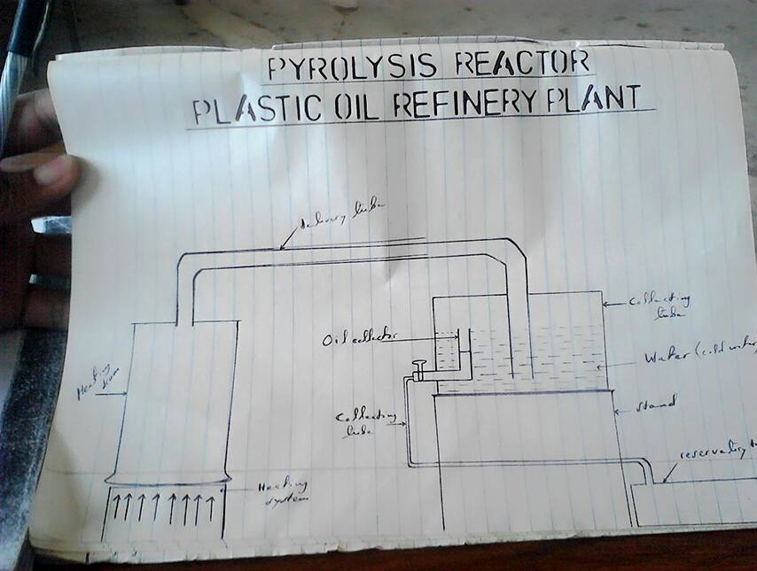
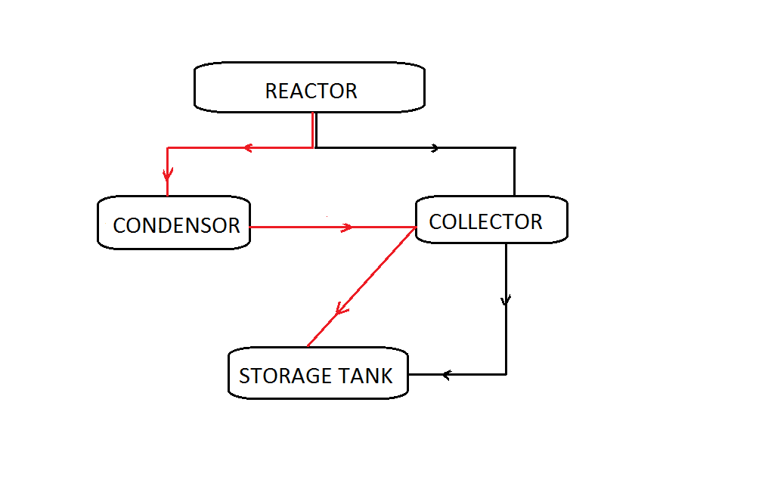
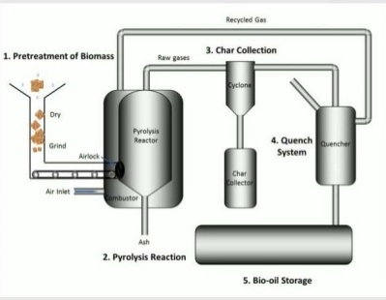
25.
Local Oil Refinery
Bariadi Secondary School
Justine Justine and Dennis Albin
Abstract:
Plastics have been great environmental pollutant in our days and their effect doesn’t ends on land only but also in water bodies(at least 250 marine species dies due to plastic derbies) and in atmosphere due to green house gases produced during inclination.
We organize the discussion “whether plastic industries should be abolished so as to save our environment”, and suggest rather than abolish these industries we have to recycle the wastes produced since they have occupied large part in our environment and it will not affect the plastic industries. Hence we come up with this project of building a plant which will turn plastics into oil, The aim of this project is to mitigate pollution caused by plastic wastes and promote environmental conservation awareness and employment opportunity.
Method:
The following were material used in our project, Drum(heating vessel), Copper pipe diameter 0.5 inch, Iron pipe diameter 2 inches, Pipe connectors
Condensing tank, Collecting tank, Storage tank, Source of heat
After gathering the materials needed the following were steps followed;
Clamp the heating vessel with bolted lid, to ensure the chamber is robust leak proof but still it is open able.
Drill the hole at centre of lid so as to allow out flow of vapour fuel.
Install the delivery tube(iron pipe) from the reactor to condensing tank and connect it to the coiled copper pipe as shown in figure 1 .
Install another pipe from the condensing tank to collecting tank.
Finally install the collecting pipe as shown from figure 1,it must be about 5cm above the water level to avoid collection of water and oil mixture down to the storage tank as it seen on diagrammatic setup in figure 1.
Results:
This machine works under the chemical process so called “PYROLYSIS”. Therefore after loading the heating vessel with plastics turn on the heat, as temperature reaches 400 ⁰C inside the reactor plastics converted into vapor which is transferred into condensing system so as to be cooled but condensation doesn’t ends in condensing system only thus the pipe should be bubbled into water in collecting tank for further cooling until the vapor comes into room temperature finally the floating oil collect into storage tank.
WARNING: Remember you deal with HIGHLY FLAMMABLE substance, therefore highly precautions must be taken including: Keep all fumes produced from the reactor away from heat and electrical points and keep fire extinguisher standby incase of an ACCIDENT!!!!
Generally at the end of experiment we obtained three products these includes Oil as a major product and Syngas and Char as minor products. We also test the efficiency of machine and it found that approximately 1littre of oil can be produced from 1kg of plastics wastes(same quantity of plastics would produce 3kg of CO₂ during incineration).
Also during our experiments various data were obtained as illustrated in tables below;
The following is analysis of data based on research conducted in Nyamagana munisple Mwanza with various people engaging in plastic collection activities where 20 people were interviewed:
Most of plastic collected are sold in low price (about 250 – 300/= Tshs) which made people engage in this activities have low living standards.
Collected plastics are mostly used in packing of local soft drinks(fruit juices),water and milk as shown on pie chart.
Temperature (⁰C) | YIELD (wt%)
 | Oil | Syngas | Char
< 400 ⁰C | 30% – 40% | 5% | 55% – 65%
400 ⁰C – 500 ⁰C | 60% – 70% | 10% – 15% | 15% – 25%
500 ⁰C > | 60% – 70% | 15% – 25% | 10% – 15%
TYPE OF PLASTIC | YIELD
PP | 95%
PP | 90%
PS | 80%
Conclusions:
If this project will be scaled up it will help a lot in promoting industrialization in our country under the policy of “TANZANIA OF INDUSTRIES” introduced by Mr President J.P. Magufuli since oil produced can be used to run various industrial machine also can be used to run generator which will help to reduce electrical costs hence costs of production will also decrease and this will increase competition in market inside and outside the country.

