Slide 1
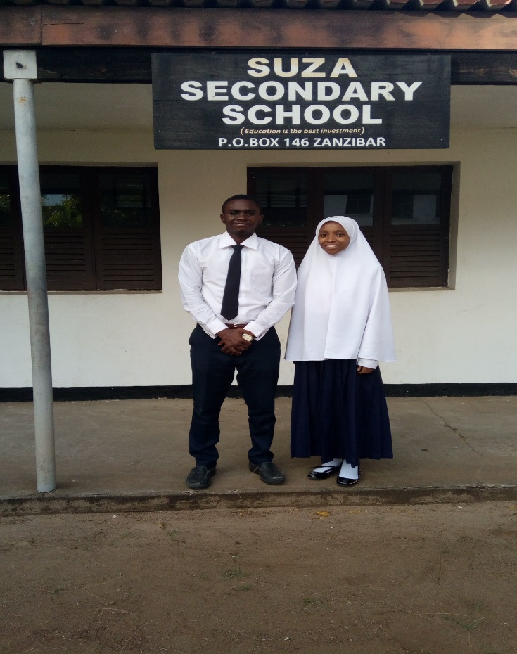
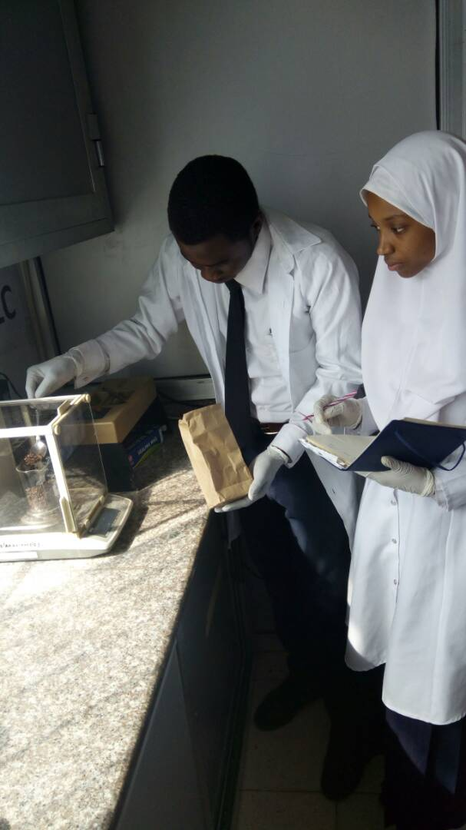
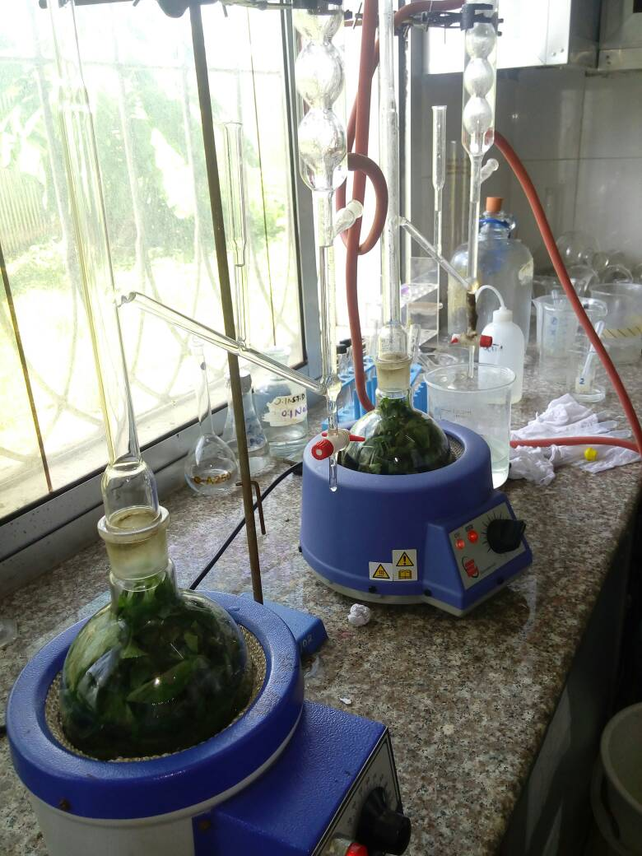
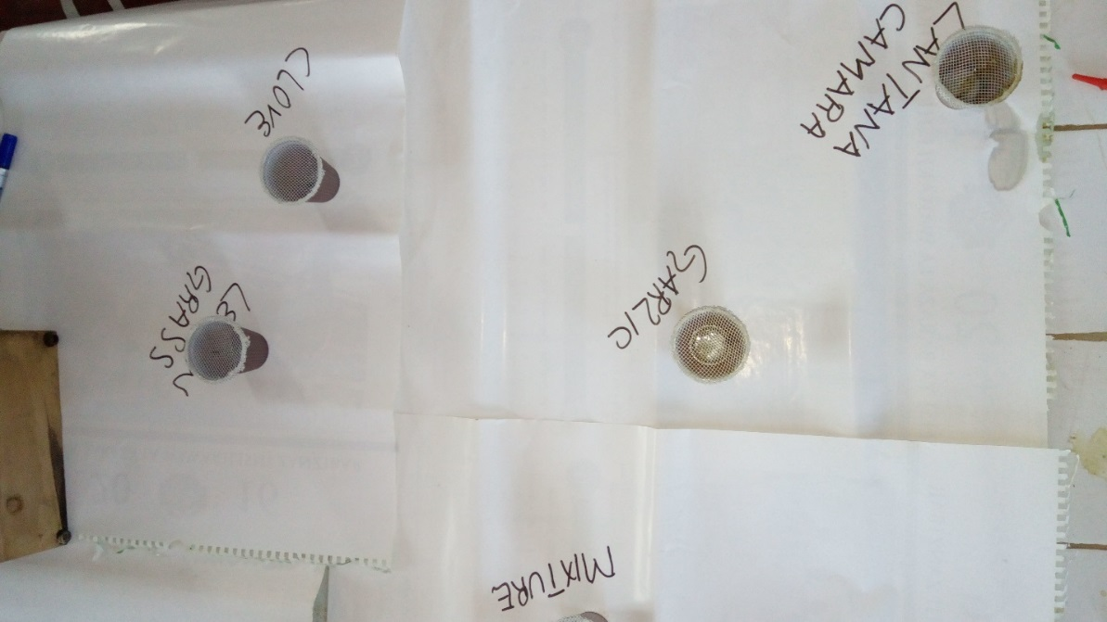
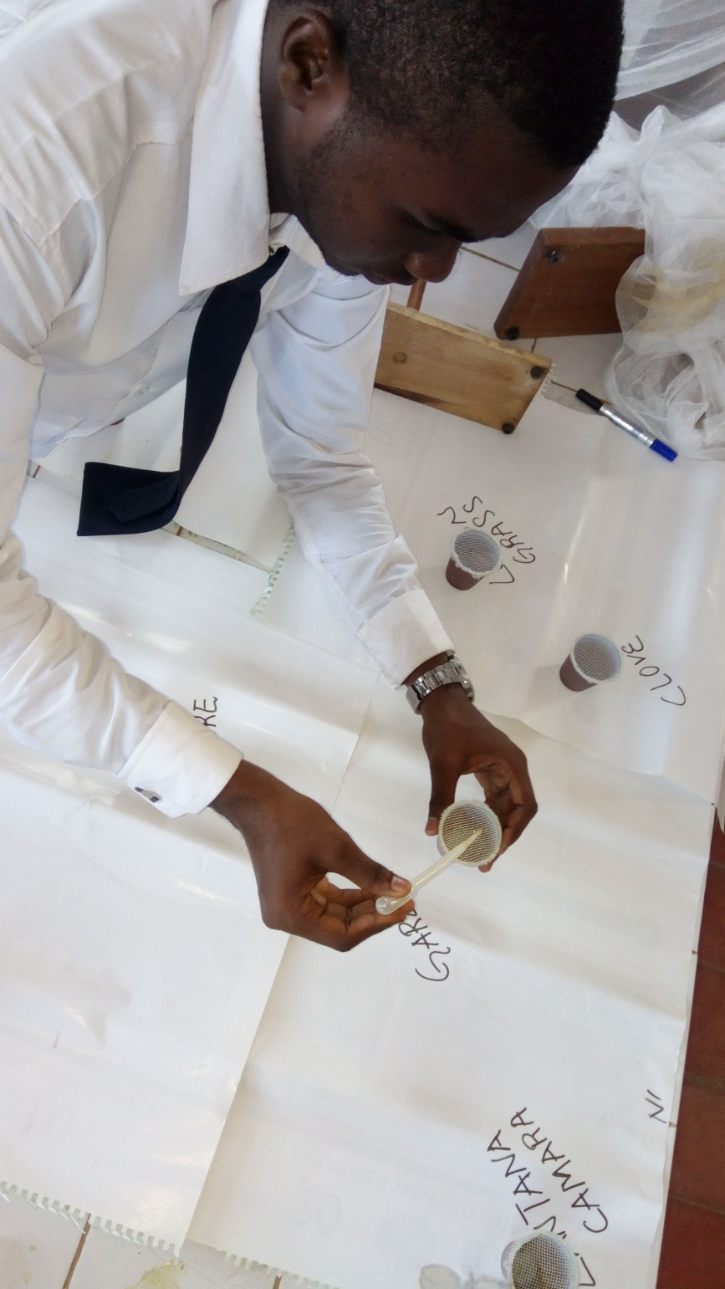
22.
En Route Edible Bug Juice
Suza Secondary School
Abdul Rahman Banisheyba and Hudhaifat Hamdan
Abstract:
Developing countries have suffered much from the modern insect killers, some results are rather catastrophic. Deaths and diseases of many kinds have been affecting many people around the globe.
En route for edible bug juice seeks to unravel the harmfulness of the modern insecticides and replacing them with the environmental friendly pesticide made from trees. This requires chemical knowledge which provides more awareness to the students on not only the chemical composition of trees but their importance
This will encourage people to make use of their natural available resources for various ways to protect themselves against predators.
Method:
Two basic methods of the experiment:
Water and Steam Distillation: Used for extracting oil of each sample.
Solution form: For producing solution of each sample.
Step 1: Sample Measurement
The fresh samples were collected; lantana and lemon grasses were plucked while garlic and cloves were bought from shops.
Lantana and lemon grasses were cut into fine pieces using scissors, the others were crashed and grinded.
The samples were then placed in 8 different beakers. Each two of the beakers contain the same sample, and the measurement is as shown in the following table:
Four separate beakers with each sample were used in steam distillation and the remaining for producing solution.
The samples were mixed with water in the conical flask for distillation and for making solution, the other four samples were blended separately using blender.
Step 2: Extraction of the samples
The samples were then heated in a round bottomed flask to about 80 °C.
Water allowed to pass through the system for cooling and collecting the sample, then the samples were turned into vapour and allowed to cool.
Oil fall into the bottom of the collecting tube ready to be separated out of the tube.
Samples | Mass of samples (g) | Volume of water (ml)
Cloves | 100 | 250
Garlic | 100 | 150
Lemon grass | 100 | 500
Lantana | 100 | 350
Sample | Gram (g) | Volume produced (ml)
Cloves | 100.0 | 20.0
Lemon grass | 100.0 | 0.2
Lantana camara | 100.0 | 0.1
Garlic | 100.0 | 0.0
Results:
The samples were evaporated after being heated to about 80 °C for extraction, this indicated that the boiling point of our samples are lower than that of water.
The extractions of essential oil from the samples produces the following results as the table aside.
The oils were tested to various insects including house flies, cockroaches and termites, and the results were as follow:
Cloves oil
Termites were concealed in a container with a few drops of clove oil in which they were struggling for a few minutes and died after 3 minutes. This indicated that clove oil is an insect killer, particularly termites.
Lemon grass oil
This was also put in a container that cockroaches were put into it and left 10 minutes. Cockroaches seemed okay and had pretty much less or no effects on them. This showed that lemon grass is harmless to cockroaches.
Conclusion:
From the results obtained from the starting of the project, it can be concluded that cloves and lemon grasses solutions are good insects’ repellents. While the lantana camara solution does repel, weaken the insects after a short time and even kill after some hours. On the case of garlic, it is a fine insect killer since it kills instantly. All act best when the surrounding is covered.
By the side of essential oils, cloves are rich in them, lemon grasses produce even in little amount but lantana camara and garlic does not consists of volatile oil (oil present have boiling points of above 100 °C.

